Slide 1
SUR MUSIC PLAYER
By,
Shubham Kothari (SE-A-38)
Aniket Kurkute (SE-A-40)
Atul Gadekar (SE-A-23)

Slide 2
Purpose
This project is for entertainment purpose
This project was made because many of the existing player didn’t have the function required in a music player

Slide 3
SELECT PLAYLIST
DEFAULT IS ALL
CREATE PLAYLIST /PLAY PLAYLIST
Sur Music Player
GUI of program
LOAD AND PLAY Music in
Player
ADD OR REMOVE
SONG FROM PLAYLIST
PLAY/ PAUSE/ STOP/
NEXT/
REWIND
VIEW LYRICS
MORE ABOUT SONG`
EDIT LYRICS
EDIT METADATA

Slide 4
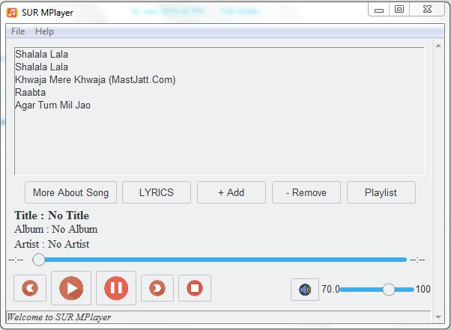
MAIN WINDOW

Slide 5
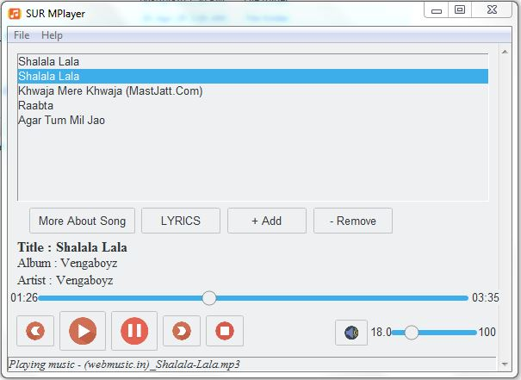
While Playing

Slide 6
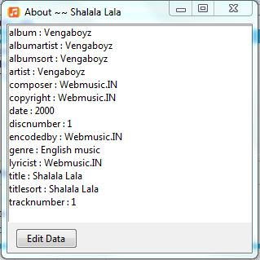
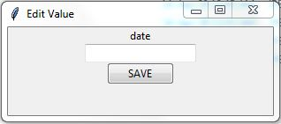
Metadata Window

Slide 7
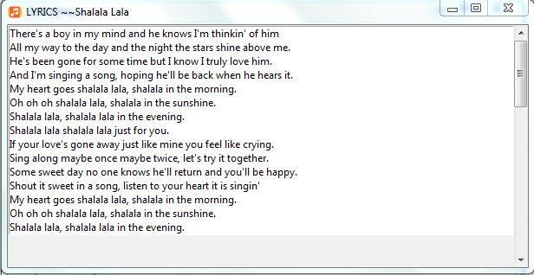
Lyrics Window

Slide 8
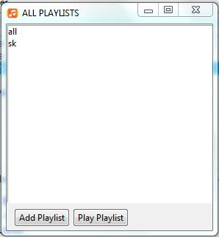
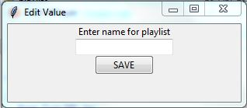
Playlist Window

Slide 9
Application
It is a Music player and will be used for playing music
It is a entertainment mean which is to be used to relax mind ands soul

Slide 10
Conclusion
This project is made for entertainment purpose
Music can be played using the project
We learnt basics of python ,use of gui , threads by doing this project

Slide 11
Reference
https://github.com/attreyabhatt/Python-Music-Player
https://www.javatpoint.com/python-tkinter-listbox
https://mutagen.readthedocs.io/en/latest/user/gettingstarted.html

Slide 12
THANK YOU

